Slide 1

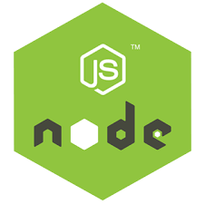

Slide 2
NODE JS

Slide 3
Introduction
Developed by Ryan Dahl in 2009
Writing JavaScript applications outside web browsers.
It is Open source, cross-platform runtime environment
Built on Google Chrome's JavaScript Engine (V8 Engine).
An event driven, non-blocking (asynchronous) I/O
  Cross-platform runtime environment for building highly scalable server-side applications

Slide 4
Introduction
Client-side JS makes heavy use of the DOM,with no access to files/databases
Server-side JS deals mostly in files/databases,
Provides a rich library of various JavaScript modules which simplifies the development of web applications
Node.js = Runtime Environment + JavaScript Library

Slide 5
NodeJs
Uses JavaScript to build entire server side application.
Can be used to build different types of applications
  command line application,
  web application,
  real-time chat application,
  REST API server etc.
  Creating an HTTP server , TCP server
  Online games
  MVC Applications

Slide 6
Parts of Node Js
Modules
  Import Module by using require directive
Servers
  A server which will listen to client's request similar to Apache HTTP Server.
Read request and return response
  Server will read HTTP request made by client
  Client can be a browser or console and return the response.

Slide 7
Installation
Download From : http://nodejs.org/#download
Check the Application Running
  Type “node” and enter
  Type ‘Hello From Node JS’
  The text gets printed shows node is installed correctly
Create a JS File
From the Command Prompt node xxx.js

Slide 8
Development Environment
Can be setup in Windows, Mac, Linux and Solaris.
The following tools/SDK help developing a Node.js application
  Node.js
  IDE (Integrated Development Environment) or TextEditor
  NPM (Node Package Manager)

Slide 9
NodeJS Console
Has virtual environment called REPL
  Read-Evaluate-Print-Loop.
started by invoking node on console
> "10 + 20"
> "Hello" + "World"
> var x = 10, y = 20;
> x + y
>function add(a, b){ return a+b; }
>add(4,5)
>console.log(‘\033c’);

Slide 10
Node.js Module:
Module are organized with single or multiple JavaScript files
  Reused throughout the Node.js application.
Node.js includes three types of modules:
  Core Modules
  Local Modules
  Third Party Modules

Slide 11
Creating Modules
Modules are loaded once, and after that they are cached by Node.
Unlike the browser, Node does not have a window global object, but instead has two others: globals and process.
  Should avoid adding properties on the two.
module.exports or exports to expose a function, object or variable as a module in Node.js.

Slide 12
Module
  var bankModule ={};
  bankModule.simpleInterest=function(){
  return "SimpleInterest Calculation Invoked";
  }
  bankModule.compoundInterest=function(){
  return "Compound Intrest calculation Invoked";
  }
  module.exports = bankModule;

Slide 13
Application
  Loading the Local Module
  var module = require("./PaymentModule.js");
  console.log(module.simpleInterest());
  console.log(module.compoundInterest());

Slide 14
Modules
  exports.calculate=function(){
  var amt = (5000 * 2 * 3)/100;
  return amt;
  }
  var obj = require("./CalculateModule.js").calculate;
  console.log(obj);

Slide 15
Modules
Many programming Languages use the import function to load other libraries
Node can also load other dependencies using the require keyword.
var http = require('http');
var dns = require('dns');
We can also require relative files:
var myFile = require('./myFile');

Slide 16
Core Module
Include bare minimum functionalities of Node.js.
Compiled into its binary distribution and load automatically when Node.js process starts.
  Need to import the core module to use it in application.
http :
  http module includes classes, methods and events to create Node.js http server.
Path
  path module includes methods to deal with file paths.
fs
  fs module includes classes, methods, and events to work with file I/O.
Util
  util module includes utility functions useful for programmers.

Slide 17
Node.js Ecosystem
Node.js heavily relies on modules,
  require keyword loaded the local modules.
Libraries in Node.js are called packages and they can be installed by typing
  npm install “package_name”;
NPM (Node Package Manager) comes bundled with Node.js installation.
Modules can be installed globally or locally to a directory of Node application

Slide 18
Node Package Manager
NPM command line tool installs, updates or uninstalls packages
An online repository for open-source Node.js packages.
It has useful modules and many deveopers publishes to it
Popular package
  AngularJS, jQuery, Gulp, Bower etc.
Official website: https://www.npmjs.com

Slide 19
Npm install
Npm always installs the latest version
Can install specific version by defining it in package.json file in the local directory
-g or --global
  to install the package globally rather than locally.
  npm root –g : will show the path of global node modules
-f or --
  force npm to fetch remote resources even if a local copy exists on disk.

Slide 20
Npm Install
Install takes optional flags which save or update the package version in your main package.json:
-S, --save:
  Package will appear dependencies.
-D, --save-dev:
  Package will appear development Dependencies.
-O, --save-optional:
  Package will appear in optional Dependencies.

Slide 21
NPM Operations
Two Modes :
  global and local.
  Global mode : Performs operations which affect all the Node.js applications on the computer
  Local mode : Performs operations for the particular local directory which affects an application in that directory only.
C:\>npm install <package name>
npm install -g latest
Global packages into <User>/local/lib/node_modulesfolder.
C:\MyNodeProj> npm install -g expressUpdate

Slide 22
Package.json
A JSON File and not a Object Literal
  Has a name and version fields. Required entries,
  package.json
  {
  "name": "file_upload", "version": "0.0.1", "dependencies": {
  "express": "^4.8.6",
  "ejs": "^1.0.0",“
  mysql": "^2.4.3"
  }}

Slide 23
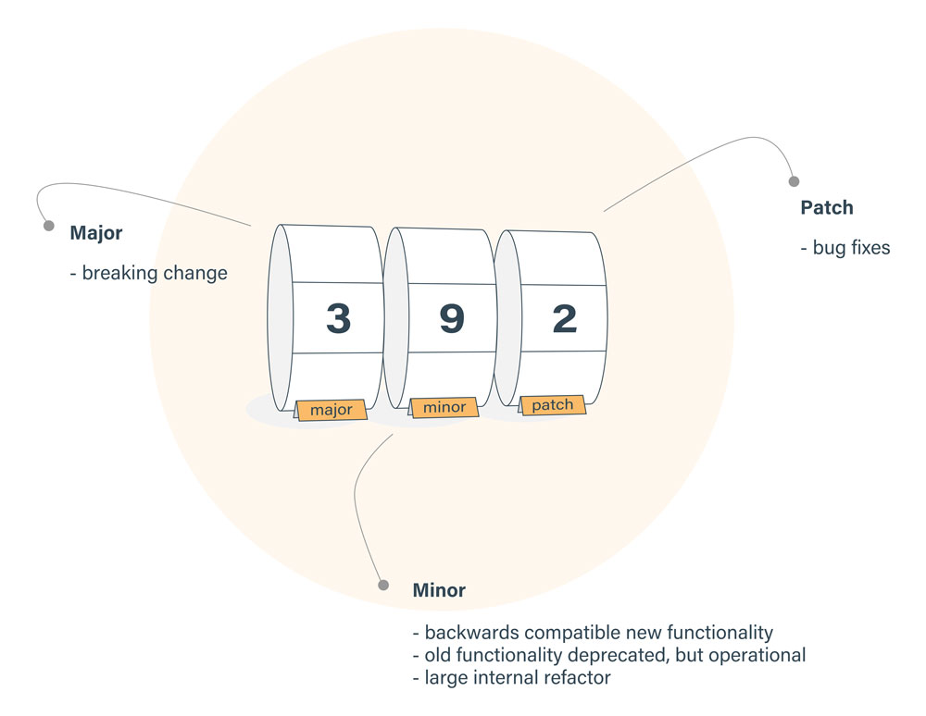
(^) Packages.json
Locks down the major version number, but leaves the minor and patch versions to be more flexible.
Version of ^2.2.3, will match any version that is greater than or equal to 2.2.3 and also less than 3.0.0.

Slide 24
(~) Packages.json
Fixes both the major and minor version numbers, while matching any patch number
~2.3.1,
  Would match all versions greater than or equal to 2.3.1 and less than 2.4.0 for that dependency.
Dependency with a version of '*' would equate to any version that was greater than or equal to 0.0.0,
while 1.* would allow versions greater than or equal to 1.0.0 and less than 2.0.0.

Slide 25
Package.json
name - name of the package
version - version of the package
description - description of the package
homepage - homepage of the package
author - author of the package
contributors - name of the contributors to the package
dependencies - list of dependencies. npm automatically installs all the dependencies mentioned here in the node_module folder of the package.
repository - repository type and url of the package
main - entry point of the package
keywords - keywords

Slide 26
REST CALLS WITH NODEJS

Slide 27
REST Overview
Resource Oriented Architecture
  Data and functionality are considered resources
  Accessed using Uniform Resource Identifiers (URIs), typically links on the Web.
A resource is accessed via a common interface based on the HTTP standard methods.
A REST server provides access to the resources and a REST client which accesses and modify the REST resources.
Resources are identified by global ID's (which are typically URIs).

Slide 28
Choosing – Resource Oriented Architectures
Involve loose-coupling between client and server, due to:
  Late binding to resource data
Successful use revolves around the cache-ability of resource data
  HTTP cache-control headers are used to specify resource to be cached.
Best for “linking and referring” across organization boundaries
Interaction are Stateless , new request should carry all the information required to complete
Must not rely on previous interactions with the same client.

Slide 29
REST Request Methods
GET - Requests a specific representation of a resource
PUT - Creates or updates a resource with the supplied representation
DELETE - Deletes the specified resource
POST - Submits data to be processed by the identified resource

Slide 30
REST with JSON Server
Can call a third party rest web service that will returns JSON data
Instead of usign a Real Web Service , could also use a mockup Rest Webservice
JSON Server
  A Node Module that can be used to create demo rest json webservice
  Done with a simple JSON file with sample data.
Installing JSON Server
    $ npm install -g json-server
  Starting JSON Server
    json-server --watch db.json

Slide 31
Creating a Mock DB
  Create a File : db.json
  {
    "invoices": [
      {
      "id": 1,
      "name": "Ramesh",
      "amount": "10000"
      },
      {
      "id":2,
      "name": "Suresh",
      "amount": "5000"
      }
    ]
    }

Slide 32
REST Client
  REST Client for Node.js Install it Locally rather globally
  $ npm install node-rest-client
  var Client=require('node-rest-client').Client;
  var client = new Client();
  client.get("http://localhost:3000/invoices",function (data, response) {
  console.log(JSON.stringify(data));
  });

Slide 33
Post Method
Utilized to **create** new resources.
Used to create subordinate resources.
Subordinate to some other (e.g. parent) resource.
POST to the parent and the service takes care of associating the new resource with the parent, assigning an ID
On successful creation, return HTTP status 201, returning a Location header with a link to the newly-created resource with the 201 HTTP status.

Slide 34
Post Request
  var Client=require('node-rest-client').Client;
  var invoice={
  "id": 6,
  "name": "Murugan",
  "amount": "20000"
  };
  var args = {
  data: invoice,
  headers: { "Content-Type": "application/json" }
  };
  var client = new Client();
  client.post("http://localhost:3000/invoices", args, function (data, response) {
  console.log(data.toString());
  });

Slide 35
Node Frequently Used Commands
Install package globally and Locally
  npm install express –g // npm install express
Uninstall package globally and Locally
  npm uninstall express –g // npm uninstall express
List global and Local packages.
  npm ls –g // npm ls -l
  npm list -g --depth=0
Update global and Local packages.
  npm update –g // npm update
Search package
  npm search express

Slide 36
Node Frequently Used Commands
To show the package registry entry
  npm view bootstrap
List of the location of globally installed modules
  npm root -g

